Slide 1
Combinational Circuits
Output is function of input only
  i.e. no feedback
  When input changes, output may change (after a delay)
Combinational
Circuits
n inputs
m outputs
•
•
•
•
•
•
✗
Notes:
Princess Sumaya University
4241 - Digital Logic Design
Dr. Bassam Kahhaleh

Slide 2
Decoders
Extract “Information” from the code
Binary Decoder
  Example: 2-bit Binary Number
Only one lamp will turn on
0
1
2
3
Binary
Decoder
1
0
0
0
x₁
x₀
0
0
Notes:
Princess Sumaya University
4241 - Digital Logic Design
Dr. Bassam Kahhaleh

Slide 3
Decoders
A decoder has
  N inputs
  2^{N} outputs
A decoder selects one of 2^{N} outputs by decoding the binary value on the N inputs.
The decoder generates all of the minterms of the N input variables.
  Exactly one output will be active for each combination of the inputs.
What does “active” mean?

Slide 4
Decoders
Convert binary information from n input lines to 2^{n} output lines.
Known as n-to-m-line decoder (m = 2^{n}).
May be used to generate the 2^{n} minterms of n input variables.

Slide 5
Decoders
In general, for an n-bit code, a decoder could select up to 2^{n} lines:
n-bit
code
n to 2^{n}
decoder
2^{n}
output lines
:
:

Slide 6
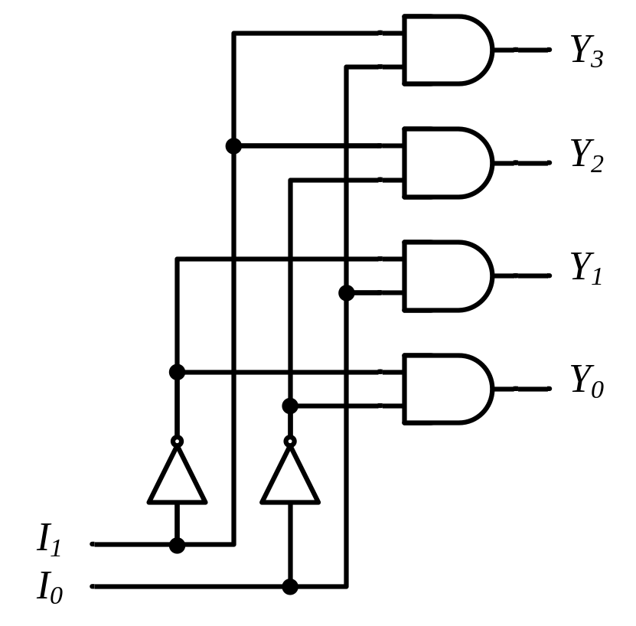
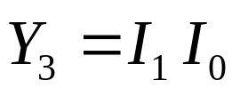
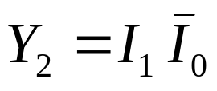
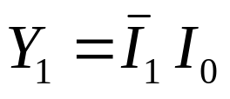
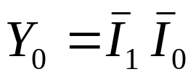
Decoders
2-to-4 Line Decoder
Binary
Decoder
y₃
y₂
y₁
y₀
I₁
I₀
I₁ I₀ | Y₃ Y₂ Y₁ Y₀
0 0 | 0 0 0 1
0 1 | 0 0 1 0
1 0 | 0 1 0 0
1 1 | 1 0 0 0
Notes:
Princess Sumaya University
4241 - Digital Logic Design
Dr. Bassam Kahhaleh

Slide 7
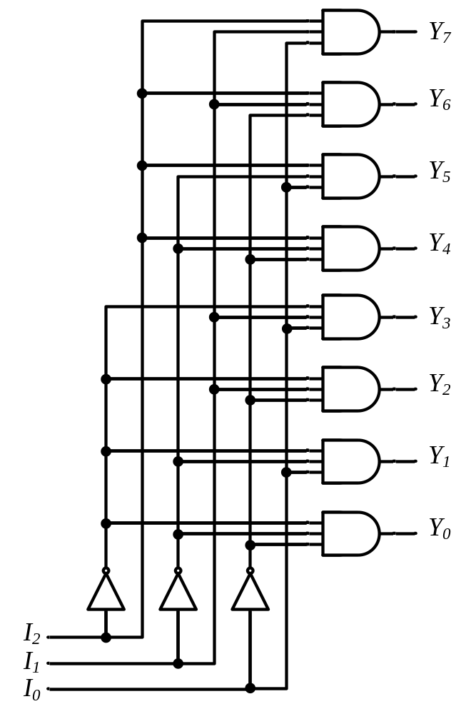






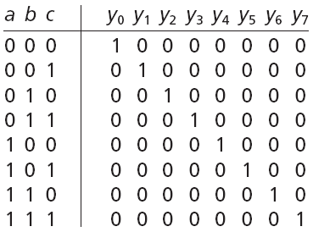


Decoders
3-to-8 Line Decoder
Binary
Decoder
Y₇
Y₆
Y₅
Y₄ Y₃
Y₂
Y₁
Y₀
I₂
I₁
I₀
Notes:
Princess Sumaya University
4241 - Digital Logic Design
Dr. Bassam Kahhaleh

Slide 8
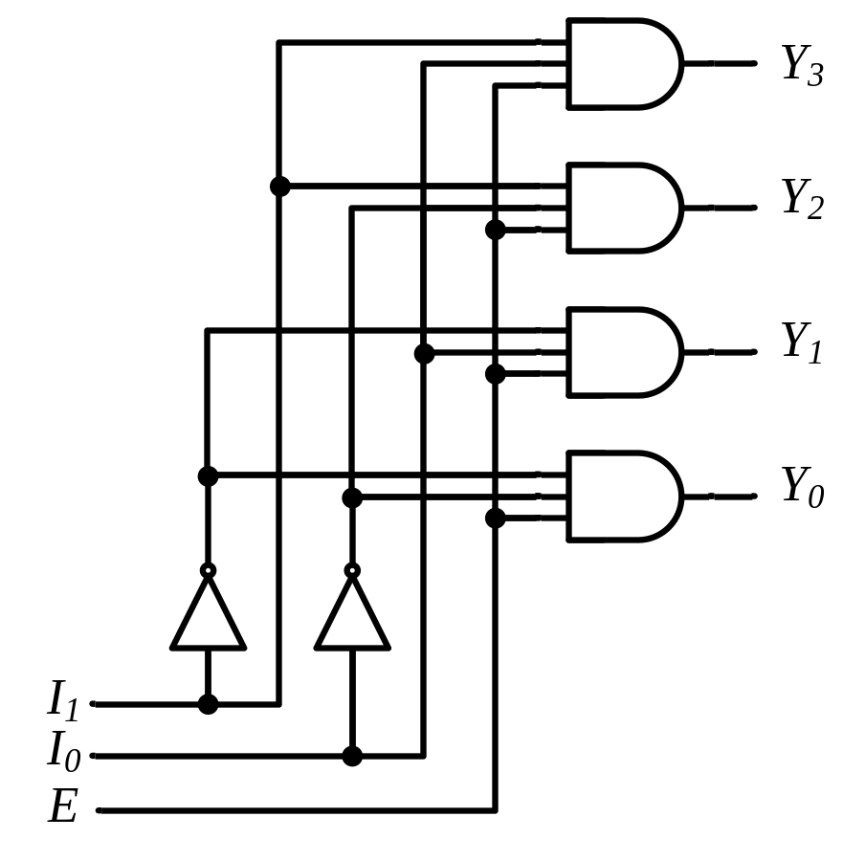
Decoders
“Enable” Control
Binary
Decoder
Y₃
Y₂
Y₁
Y₀
I₁
I₀
E
E | I₁ I₀ | Y₃ Y₂ Y₁ Y₀
0 | x x | 0 0 0 0
1 | 0 0 | 0 0 0 1
1 | 0 1 | 0 0 1 0
1 | 1 0 | 0 1 0 0
1 | 1 1 | 1 0 0 0
Notes:
Princess Sumaya University
4241 - Digital Logic Design
Dr. Bassam Kahhaleh

Slide 9

Decoders
Expansion
I₂ I₁ I₀
I₂ I₁ I₀ | Y₇ Y₆ Y₅ Y₄ Y₃ Y₂ Y₁ Y₀
0 0 0 | 0 0 0 0 0 0 0 1
0 0 1 | 0 0 0 0 0 0 1 0
0 1 0 | 0 0 0 0 0 1 0 0
0 1 1 | 0 0 0 0 1 0 0 0
1 0 0 | 0 0 0 1 0 0 0 0
1 0 1 | 0 0 1 0 0 0 0 0
1 1 0 | 0 1 0 0 0 0 0 0
1 1 1 | 1 0 0 0 0 0 0 0
Binary
Decoder
Y₇
Y₆
Y₅
Y₄
Y₃
Y₂
Y₁
Y₀
Y₃
Y₂
Y₁
Y₀
I₀
I₁
E
Binary
Decoder
Y₃
Y₂
Y₁
Y₀
I₀
I₁
E
Notes:
Princess Sumaya University
4241 - Digital Logic Design
Dr. Bassam Kahhaleh

Slide 10
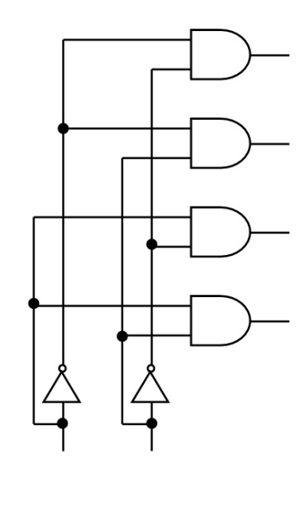
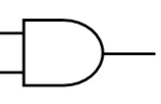

Decoder Expansion
Build a decoder with n+1 inputs using n-input decoder.
A₂A₁A₀
000
010
001
011
100
110
101
111
A₀
A₁
A₂

Slide 11
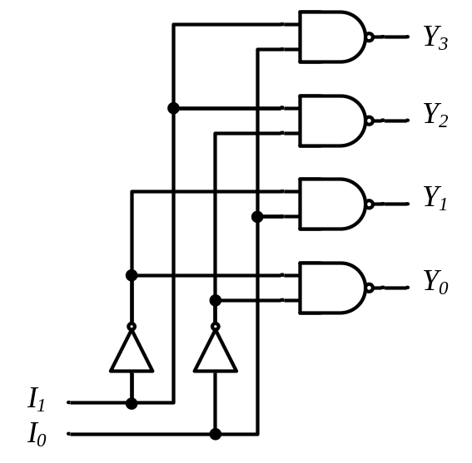
Decoders
Active-High / Active-Low
I₁ I₀ | Y₃ Y₂ Y₁ Y₀
0 0 | 0 0 0 1
0 1 | 0 0 1 0
1 0 | 0 1 0 0
1 1 | 1 0 0 0
I₁ I₀ | Y₃ Y₂ Y₁ Y₀
0 0 | 1 1 1 0
0 1 | 1 1 0 1
1 0 | 1 0 1 1
1 1 | 0 1 1 1
Binary
Decoder
Binary
Decoder
Y₃
Y₂
Y₁
Y₀
Y₃
Y₂
Y₁
Y₀
I₁
I₀
I₁
I₀
Notes:
Princess Sumaya University
4241 - Digital Logic Design
Dr. Bassam Kahhaleh

Slide 12
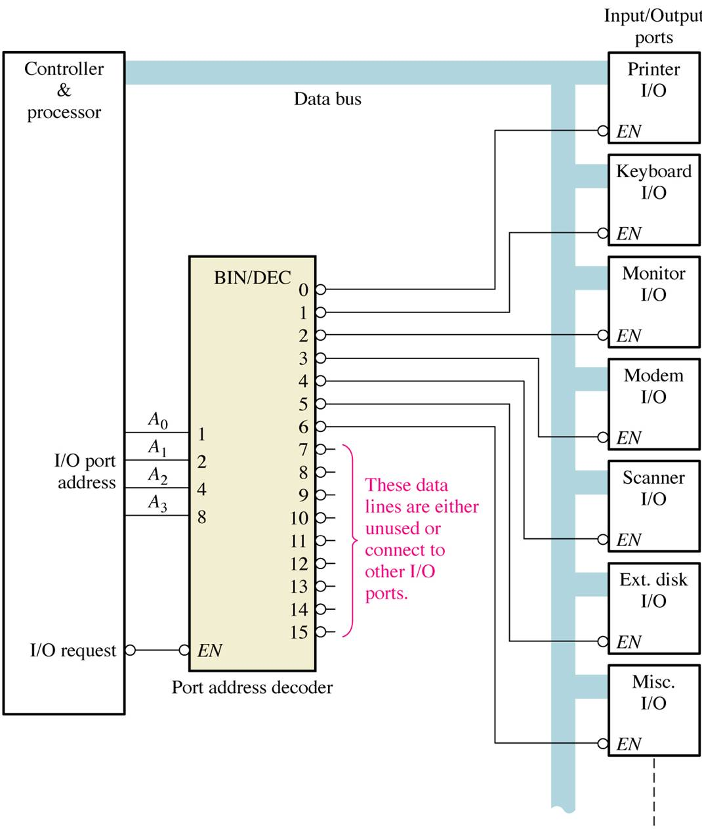
Application example
A simplified computer I/O port system with a port address decoder with only four address lines shown.

Slide 13
Decoders are used in many types of applications. One example is in computers for I/O selection as in previous slide
Computer must communicate with a variety of external devices called peripherals by sending and/or receiving data through what is known as input/output (I/O) ports
Each I/O port has a number, called an address, which uniquely identifies it. When the computer wants to communicate with a particular device, it issues the appropriate address code for the I/O port to which that particular device is connected . The binary port address is decoded and appropriate decoder output is activated to enable the I/O port
Binary data are transferred within the computer on a data bus, which is a set of parallel lines

Slide 14
Decoder Applications
• Microprocessor memory systems
– selecting different banks of memory
• Microprocessor input/output systems
– selecting different devices (printer, serial, video etc)
• Microprocessor instruction decoding
– enabling different functional units within the uP.
• Memory chips
– enabling different rows of memory depending on inputted address
• Identifying or selecting various circuit options.
Can also be used for logic synthesis since each output actually
represents a unique minterm of the inputs…….

Slide 15
Applications of Decoder
Used in counter systems
Used in Analog to Digital Converters
Decoder outputs can be used to drive a display systems

Slide 16

Implementation Using Decoders
Each output is a minterm
All minterms are produced
Sum the required minterms
Example: Full Adder
S(x, y, z) = ∑(1, 2, 4, 7)
C(x, y, z) = ∑(3, 5, 6, 7)
Binary
Decoder
Y₇
Y₆
Y₅
Y₄ Y₃
Y₂
Y₁
Y₀
x
y
z
I₂
I₁
I₀
S C
Notes:
Princess Sumaya University
4241 - Digital Logic Design
Dr. Bassam Kahhaleh

Slide 17



Implementation Using Decoders
Binary
Decoder
Binary
Decoder
Y₇
Y₆
Y₅
Y₄ Y₃
Y₂
Y₁
Y₀
Y₇
Y₆
Y₅
Y₄
Y₃
Y₂
Y₁
Y₀
x
y
z
I₂
I₁
I₀
x
y
z
I₂
I₁
I₀
S C
S C
Notes:
Princess Sumaya University
4241 - Digital Logic Design
Dr. Bassam Kahhaleh

Slide 18
Encoders
An encoder has
  2^{N} inputs
  N outputs
An encoder outputs the binary value of the selected (or active) input.
An encoder performs the inverse operation of a decoder.
Issues
  What if more than one input is active?
  What if no inputs are active?

Slide 19
Encoder
An encoder is a combinational logic circuit that essentially performs a “reverse” of decoder functions.
An encoder accepts an active level on one of its inputs, representing digit, such as a decimal or octal digits, and converts it to a coded output such as BCD or binary.
An encoder has a number of input lines, only one of which input is activated at a given time and produces an N-bit output code, depending on which input is activated.

Slide 20
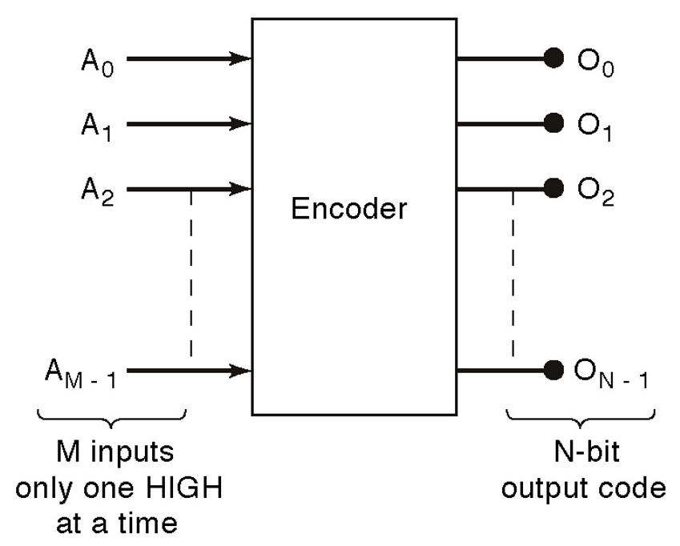
General encoder diagram

Slide 21
Encoders
D
I₀
C
I₁
Out₀
Z
Out₁
Y
B
I₂
A
I₃
A | B | C | D | Y | Z
0 | 0 | 0 | 1 | 0 | 0
0 | 0 | 1 | 0 | 0 | 1
0 | 1 | 0 | 0 | 1 | 0
1 | 0 | 0 | 0 | 1 | 1

Slide 22
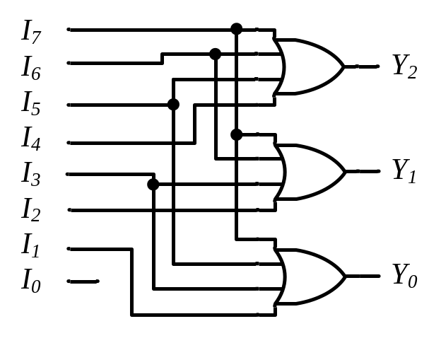
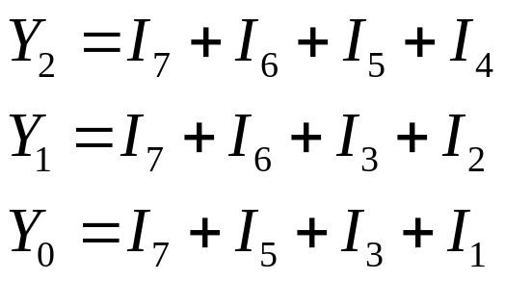
Encoders
Binary
Encoder
Octal-to-Binary Encoder (8-to-3)
I₇
I₆
I₅
I₄ I₃
I₂
I₁
I₀
I₇ I₆ I₅ I₄ I₃ I₂ I₁ I₀ | Y₂ Y₁ Y₀
0 0 0 0 0 0 0 1 | 0 0 0
0 0 0 0 0 0 1 0 | 0 0 1
0 0 0 0 0 1 0 0 | 0 1 0
0 0 0 0 1 0 0 0 | 0 1 1
0 0 0 1 0 0 0 0 | 1 0 0
0 0 1 0 0 0 0 0 | 1 0 1
0 1 0 0 0 0 0 0 | 1 1 0
1 0 0 0 0 0 0 0 | 1 1 1
Y₂
Y₁
Y₀
Notes:
Princess Sumaya University
4241 - Digital Logic Design
Dr. Bassam Kahhaleh

Slide 23
Encoder Design Issues
  Only one input can be active at any given time.
    If two inputs are active simultaneously, the output produces an undefined combination
      (for example, if D₃ and D₆ are 1 simultaneously, the output of the encoder will be 111.
A₀ = D₁ + D₃ + D₅ + D₇
A₁ = D₂ + D₃ + D₆ + D₇
A₂ = D₄ + D₅ + D₆ + D₇

Slide 24
Priority Encoders
If more than one input is active, the higher-order input has priority over the lower-order input.
  The higher value is encoded on the output
A valid indicator, v, is included to indicate whether or not the output is valid.
  Output is invalid when no inputs are active
    v = 0
  Output is valid when at least one input is active
    v = 1
Why is the valid indicator needed?

Slide 25
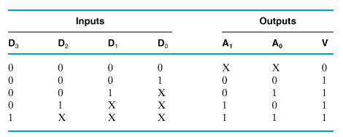
Priority Encoder
  Multiple asserted inputs are allowed; one has priority over all others.

Slide 26
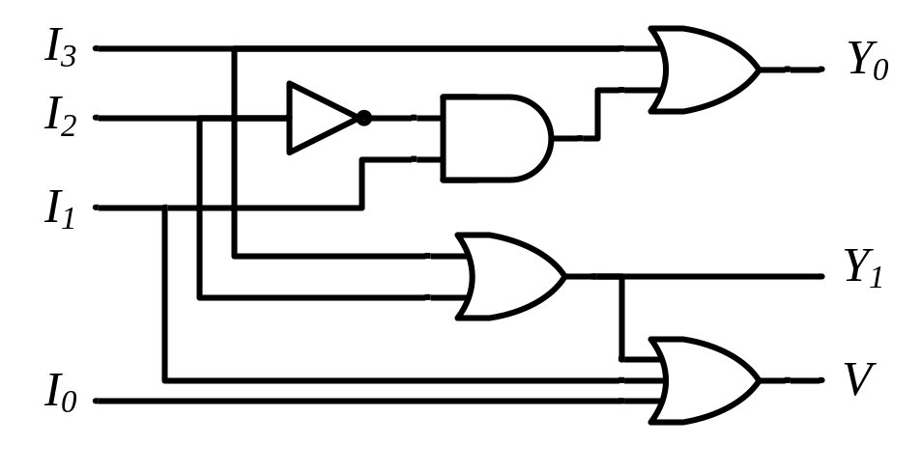
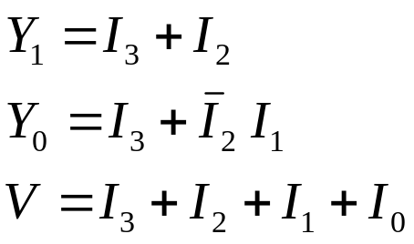
Priority Encoders
4-Input Priority Encoder
Priority
Encoder
I₃
I₂
I₁
I₀
V
Y₁
Y₀
I₃ I₂ I₁ I₀ | Y₁ Y₀ | V
0 0 0 0 | 0 0 | 0
0 0 0 1 | 0 0 | 1
0 0 1 x | 0 1 | 1
0 1 x x | 1 0 | 1
1 x x x | 1 1 | 1
Y₁ |  |  |  | I₁
 |  | 1 | 1 | 1 | 1 | I₂
I₃ |  | 1 | 1 | 1 | 1
 |  | 1 | 1 | 1 | 1
 |  |  | I₀
Notes:
Princess Sumaya University
4241 - Digital Logic Design
Dr. Bassam Kahhaleh

Slide 27

Encoder / Decoder Pairs
Binary
Encoder
Binary
Decoder
Y₇
Y₆
Y₅
Y₄ Y₃
Y₂
Y₁
Y₀
7
7
I₇
I₆
I₅
I₄ I₃
I₂
I₁
I₀
6
6
5
5
Y₂
Y₁
Y₀
I₂
I₁
I₀
4
4
3
3
2
2
1
1
0
0
Notes:
Princess Sumaya University
4241 - Digital Logic Design
Dr. Bassam Kahhaleh

